Slide 1
软件工程导论
Introduction to Software Engineering
王湖南
wanghunan@scu.edu.cn
四川大学软件学院软件工程系

Slide 2
Instructor Information
Instructor：王湖南
  Email: wanghunan@scu.edu.cn
  QQ:**********
Resume
  1992、9-1996、7 电子科技大学 (UESTC)
  1996、7-1999、9 中国科学院成都分院计算机应用研究所
  1999、9-2002、4 电子科技大学 (UESTC)
  2002、4-now 四川大学计算机（软件）学院

Slide 3
Instructor Information (con.)
Maxim
“机会总是青睐有准备的人”

Slide 4
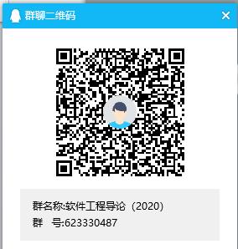
Teaching assistant
Assistant:邵泽端
Email: 1095115287@qq.com
课程qq群号：623330487

Slide 5
Introduction to SE

Slide 6
Quiz (10 minutes)
Did you know or use following concepts? Please give a brief description for each as your opinion.
    Software Requirements（软件需求）
    Software modeling and analysis （软件建模与分析）
    Software Design（软件设计）
    Software Coding（软件编码）
    Software Verification and Validation（软件验证与确认）
    Software Testing（软件测试）
    Software Operation and Maintenance（软件运行与维护）
    Software Evolution（软件进化）
    Software Management（软件管理）
    Software Process（软件过程）

Slide 7
Questions
为什么要研究软件工程？
什么是软件工程？
软件工程研究的内容是什么？
软件工程的特点是什么？
如何研究软件工程？

Slide 8

实例1：
美国IBM公司在1963年至1966年开发的IBM360机的操作系统。
这一项目花了5000人一年的工作量，最多时有1000人投入开发工作，写出了近100万行源程序。
据统计，这个操作系统每次发行的新版本都是从前一版本中找出1000个程序错误而修正的结果。
这个项目的负责人F. D. Brooks事后总结了他在组织开发过程中的沉痛教训时说：“......程序设计工作正像这样一个泥潭，......一批批程序员被迫在泥潭中拼命挣扎，......谁也没有料到问题竟会陷入这样的困境......”。
IBM360操作系统的历史教训成为软件开发项目的典型事例为人们所记取。

Slide 9
实例2：
1996年，美国 Washington Post 报导
Dallas, Aug. 23 — 美国航空公司一架直升飞机撞上山崖，造成163人死亡。
原因：飞行目的地代码输入错误。
驾驶Boeing 757的机长认为他输入了目的地Cali的单字符代码，通常在大多数计算机数据库中Cali和Bogota的代码是不同的，而在南美的航空资料中， Cali的单字符代码和Bogota的是一样，所以系统将目的地处理成了Bogota。

Slide 10
软件开发的问题——软件使用率
Software used, but criticized or dropped
19%
Software used after
modifications
3%
Software paid for but
never delivered
29.7%
Software delivered
and used as is
2%
Software delivered but
never used
47%
1982: Nine DOD contracts amounting to $6.8 million
(source: GAO, quoted in CMU/SEI-93-EM-8)
Notes:
GAO: General Accounting Office (http://www.gao.gov)

Slide 11
软件开发的问题——软件开发的分工
Distribution of the development effort:
Common belief
Specification
Testing
Design
Encoding

Slide 12
软件开发的问题——软件开发实际
Distribution of the development effort:
What actually happens
Specification
Design
Coding
Testing
Maintenance

Slide 13
硬件和软件的故障率
Failure
Rate
"Infant
Mortality"
”Wear
& tear"
Change
Actual
Ideal
Time
Time
FAILURE CURVE
FOR HARDWARE
FAILURE CURVE
FOR SOFTWARE
* Software Engineering, Module 1, Richard Conn, University of Cincinnati, May 1993
Notes:
Hardware tends to have a wear-in time during which it has a higher probability of failure. This is generally referred to as infant mortality. Once the initial period is passed, hardware tends to operate without failure until components age enough to cause breakdown.
Lesson to be drawn
Do not buy extended warranty contracts.
Standard warranty is usually long enough to
take you through the infant mortality period.
Software also shows an early error rate, but updates should remove the most obvious problems which render the software unreliable. Updates for added functionalities often add more problems, as is shown by the spikes on the software failure curve. As updates are made, more latent errors appear in the software making it less and less reliable until it becomes too unreliable for use. The software then undergoes a major redesign and is rewritten.

Slide 14
问题：
        如何进行软件开发？
如何保证软件的质量、成本和进度？
方法学问题！！

Slide 15
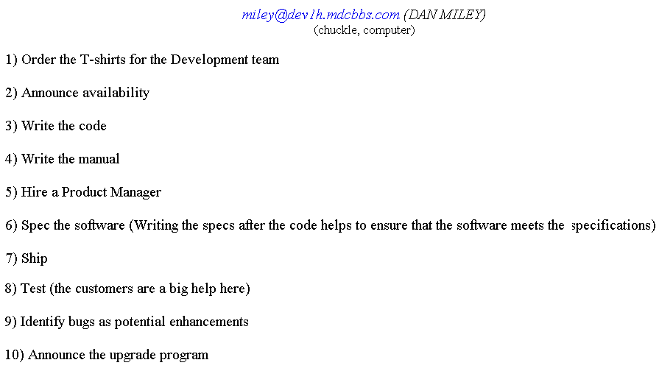
Familiar Problems ….

Slide 16
什么是软件工程（Software Engineering）?
The application of a systematic, disciplined, quantifiable approach to the development, operation and maintenance of software; that is, the application of engineering to software.
运用系统的、规范的、可量化的方法开发、运行和维护软件，即将工程化的方法运用到软件开发中。
(IEEE Standard Glossary of Software Engineering, 1990)

Slide 17
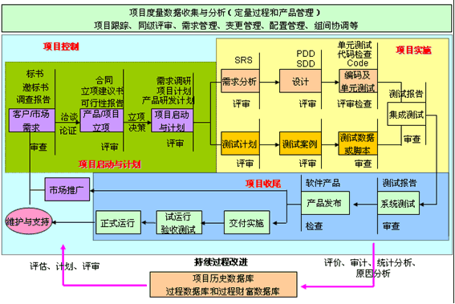
软件工程相关活动

Slide 18
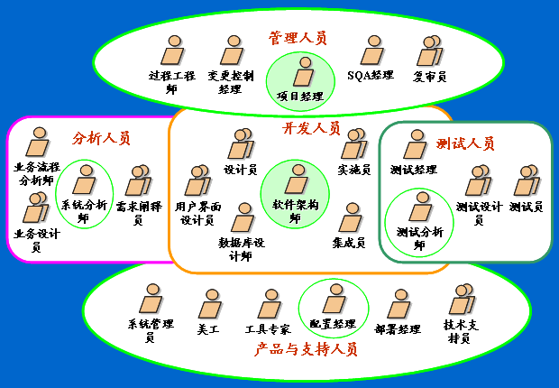
软件工程中的角色

Slide 19
什么是软件工程？
运用系统的、科学的、可度量的方法开发、运行和维护软件；
研究软件开发、运行和维护的工程化过程、方法和工具；
软件工程是建立在计算机科学和数学的基础上；
软件工程=计算机科学+管理+工程

Slide 20
与软件工程相关的学科
  计算机工程
  计算机科学
  管理
  数学
  项目管理
  质量管理
  软件人类工程学
  系统工程

Slide 21
软件工程与计算机科学的关系
计算机科学 | 软件工程
是一门科学，研究信息和计算的理论基础，以及在计算机系统应用中的具体实现技术 | 是一门工程学科，它要求以系统化、可控制和有效的工程化方法创建高质量的软件。
涉及到相关的数学和计算理论，包括描述和变换信息的算法、有效地自动化等。 | 涉及到相关的质量、规划、经济、知识、应用等方面的原理和方法。
知识领域：计算理论、算法和数据结构、编程方法和语言、计算机组成和体系结构、通信和网络、安全、数据库、计算机图形、科学计算、人工智能、人机交互等。 | 知识领域：软件需求、软件设计、软件构造、软件测试、软件维护、软件配置管理、软件工程管理、软件工程过程、软件工程工具和方法、软件质量等。
涉及数学、计算学科。 | 涉及计算机科学、管理、工程等学科。

Slide 22
软件工程与传统工程的关系
软件工程 | 传统工程
基础是计算机科学 | 基础是自然科学
数学基础是离散数学 | 数学基础是连续数学
研究的对象是抽象和逻辑实体 | 研究的对象是具体的物理对象
软件没有制造过程 | 大多有生产、构造过程
软件维护是一个持续开发的过程或改进的过程 | 有比较明确的完成结点
软件不能被用尽 | 可以被用尽

Slide 23
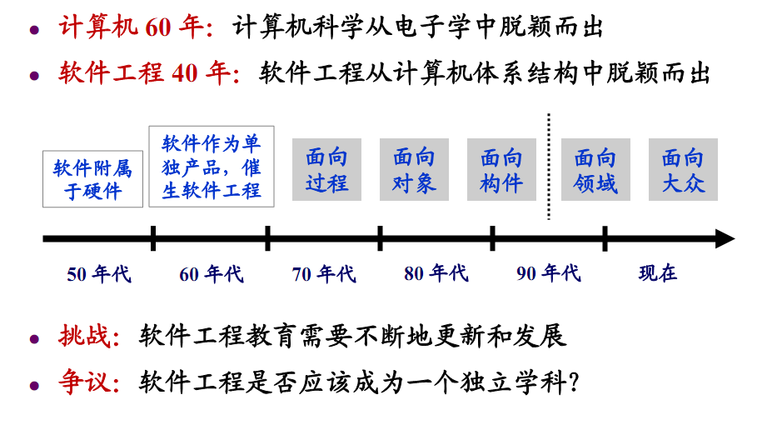
软件工程学科

Slide 24
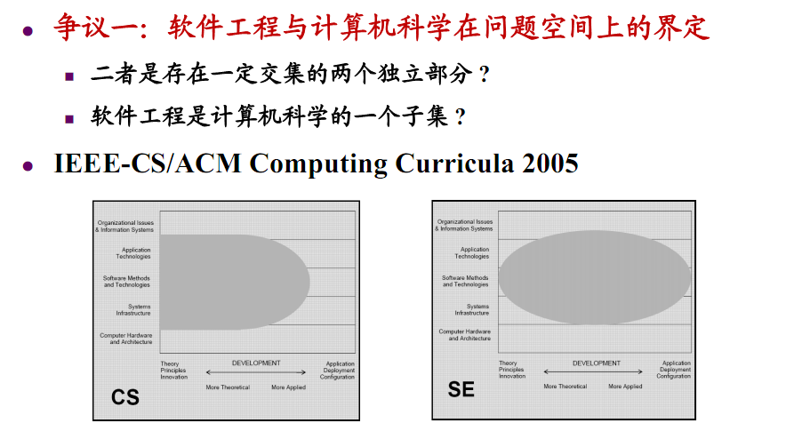
软件工程学科

Slide 25
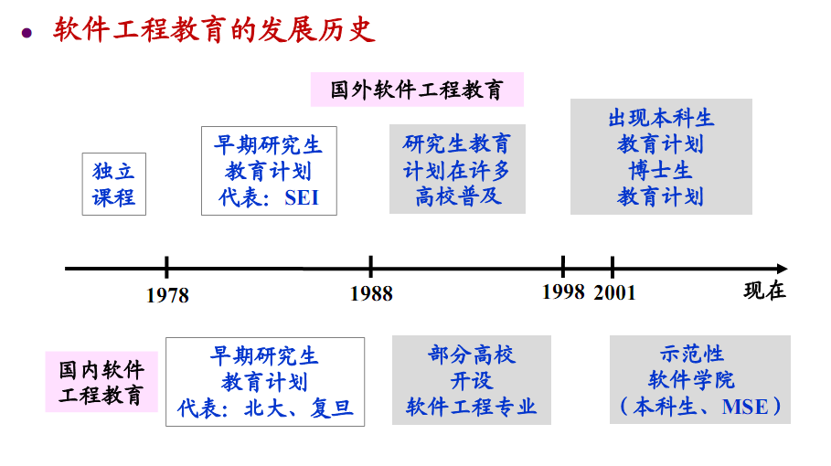
软件工程教育

Slide 26
软件工程师的理想素质
决策能力
定量分析能力
团队协作能力
多重角色的承担
工具运用能力
社会交流能力
成果的重用能力

Slide 27
软件工程专业学生的基本要求
掌握软件工程的知识，技能和专业问题；
能够独立或作为团队成员开发和提交高质量的软件产品；
能综合考虑成本、实践、知识、现有系统和组织关系等因素解决项目中的问题；
用软件工程方法在一个或多个应用领域设计适当的解决方案，涉及道德，社会，法律和经济相关的问题；
理解现有的问题识别和分析，软件设计，开发，实现，验证和文档编写的理论，方法和技术，并能够应用。
理解和正确评价在一个典型的软件开发环境谈判，有效工作习惯，领导能力和良好客户沟通能力的重要性。
学习新的模型和技术。

Slide 28
Introduction to the Course

Slide 29

Question:
Why do I need to learn software engineering?
To be a software engineer or a IT engineer……

Slide 30
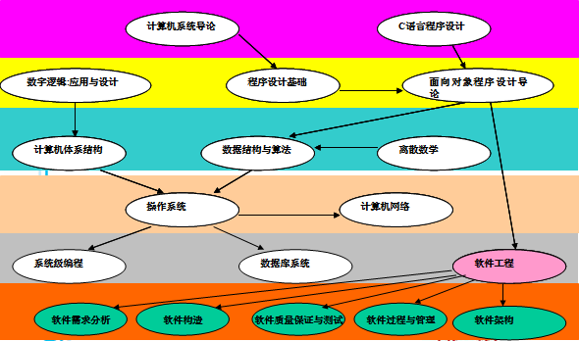
The Relationship with Other Courses

Slide 31
Job in Software Engineering
应用软件开发：
  分析、设计和实现
软件开发服务和管理：
  系统集成和测试、系统维护、技术支持、市场营销、软件项目管理等
软件应用领域服务;
软件工程领域学术研究、教育、咨询;
其它

Slide 32

2013 Top 10 Best Jobs in U.S.A.
1 精算师 （ Actuary）
2 生物医药工程师
3 软件工程师（Software Engineer）
4 听觉学专家 （Audiologist）
5 财务计划师（Financial Planner）
6 牙科保健员（Dental Hygienist）
7 职业治疗师 （Occupational Therapist)
8 验光师
9 物理治疗员
10 计算机系统分析师（Computer Systems Analyst）
-美国就业网站“CareerCast”

Slide 33
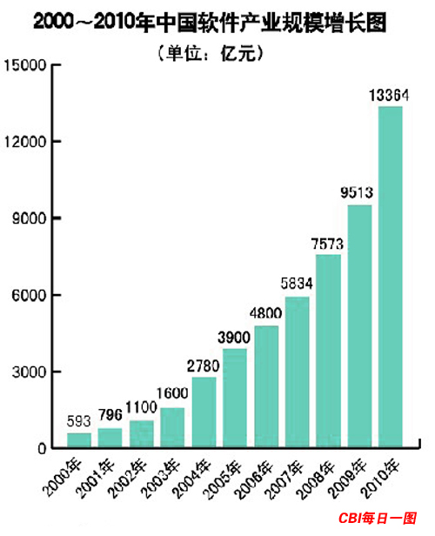

Slide 34
2012 Top 10 Best Jobs in China
软件工程师
设计师
机械工程师
销售总监
教师
采购经理
理财/投资顾问
网络市场营销
店长/楼面经理
财务经理
-前程无忧

Slide 35
Top 10 Things Every Software Engineer Should Know
Fundamentals of Emotional Intelligence（情感智能）
Understand the Business of your Customer
Minimum One Programming Language for each Mainstream Development Paradigm（主流开发模式）
Know your Tools
Standard Data Structures, Algorithms and Big-O-Notation
Don’t Trust Code without Adequate Test
Basics of Project Management, Lean Management and Agile Concepts
Key Metrics of Software Development
The Root Cause of the Last Defect
Understand the Infrastructure
By Markus Sprunck

Slide 36

Question:
What should I learn from this course?
In brief , you will learn how to develop software.
You will know what’s difference between programming and development.
Further, you will learn how to think and to solve problem.

Slide 37

Course Content
Unit 1 Introduction (3)
Unit 2 Process Models(3)
Unit 3 Understanding Requirements(3)
Unit 4 Requirements Modeling(6)
Unit 5 Design Concepts (3)
Unit 6 Architectural Design(1.5)
Unit 7 Component-level Design(1.5)
Unit 8 User Interface Design (1.5)
Unit 9 Software Testing Strategies (1.5)
Unit 10 Testing Application (1.5)
Unit 11 Software Configuration Management(1.5)
Unit 12 Managing Software Projects (3)

Slide 38
Course Lab
Lab 1 UML modeling of system (5)
Lab 2 GUI Design(5)
Lab 3 Software Testing (5)
Lab 4 Software Development Plan(5)

Slide 39
about textbook
Textbook：《software Engineering A Practitioner’s Approach》8th Edition, Roger S. Pressman, 2015, China Machine Press

Slide 40
About resource
《Software Engineering》9th Edition, Ian Somerville, 2009, China Machine Press
《Object-Oriented and Classical Software Engineering》8th Edition, Stephen R. Schach, 2010 China Machine Press
http://www.mhhe.com/engcs/compsci/pressman
http://www.acm.org
http://ieeexplore.ieee.org
http://www.umlchina.com
http://www.sei.cmu.edu
http://www.csai.cn
http://research.microsoft.com
http://www.51cmm.com
。。。。。。。。

Slide 41
About Grading
Peacetime(40%)
  Class Participation (10%)
  Assignments (20%)
  Experiments(10%)
Midterm (20%)
Final exam (40%)

Slide 42

Class Participation
课前阅读、准备；
课堂出勤(课堂签到,缺勤30%以上不得参加期末考试)；
做笔记（教材、讲义、笔记本、纸、笔）；
课堂讨论、交流、回答问题；
课堂小测验；
课堂报告；
课程网站互动参与；
其它；
To be active!

Slide 43

assignments
文档命名：学号-姓名-章节号；
文档格式：.DOC 或 .PDF；
提交时间：每周周一之前，提交网站： http://cc.scu.edu.cn/
提醒：
  杜绝作业抄袭，一旦发现，平时成绩一律按照0分处理；
  按时提交作业,无特殊情况不得补交作业;

Slide 44
About course website
四川大学课程中心：http://cc.scu.edu.cn/
课程： 软件工程导论（王湖南2020）
教材学习网站： http://www.mhhe.com/pressman/
要求本周内在课程网站内注册！

Slide 45
课程参考文献
全球最有影响力的软件工程期刊：
• Transactions on Software Engineering （ IEEE ）
• Software （ IEEE ）
• Software Engineering Notes （ ACM Special Interest Group ）
• Transactions on Software Engineering and Methodology （ ACM ）
• The Journal of Systems and Software （ Elsevier ）
• Proceedings of the International Conference on Software Engineering （ ACM ／ IEEE ）
• Proceedings of the International Conference on Software Maintenance （ IEEE ）
• Software Maintenance: Research and Practice （ Wiley ）

Slide 46
Introduction
Ref: Chapt. 1

Slide 47

The Law of Unintended Consequence（非故意结果）
Computer software can have profound and unexpected effects on:
  Science
  Business
  Engineering
  Commercial
  People, and
  Culture
  None could have foreseen!

Slide 48
Where is Software?
软件已运用到政府、银行和金融、教育、交通、娱乐、医疗、农业和法律等方面：
  以网络为中心的系统
  信息系统和数据处理
  金融和电子商务系统
  生物医学系统
  多媒体、游戏和娱乐系统
  嵌入式和实时系统
  容错和免疫系统
  。。。。。。
  有没有或不能用软件的地方吗？
Transportation
Medical
Telecommunications
Military
Industrial
Entertainment
Office Machines
Education
etc.

Slide 49
Key Point
Ideas and technological discoveries are the driving engines of economic growth.
------ The Wall Street Journal

Slide 50
Outline
The Evolving Role of Software
Software
The Changing Nature of Software
Legacy Software
Software Myths

Slide 51
Software’s Dual Role（双重作用）
Software is a product
  Transforms information - produces, manages, acquires, modifies, displays, or transmits information
  Delivers computing potential of hardware and networks
Software is a vehicle（载体） for delivering a product
  Controls other programs (operating system)
  Effects communications (networking software)
  Helps build other software (software tools & environments)
Notes:
Information transformer - function behavior
Computing potential - non-functional behavior
Example of functional behavior?
Type characters into keyboard => word processor displays them on screen
Input program file => compiler translates to byte code
Example of non-functional behavior?
Type character in instant messenger => appears on friend’s screen
Compile large program within a few seconds
Performance - time and space
Vehicle for product delivery
Examples of SW controllers (other than OS)
Examples of communication SW
Examples of development tools

Slide 52
Outline
The Evolving Role of Software
Software
The Changing Nature of Software
Legacy Software
Software Myths

Slide 53
The Definition of Software
Software is:
Instructions that when executed provide desired features, functions, and performance;
Data structures that enable the programs to adequately manipulate information; and
Documents that describe the operation and use of the programs
Services that support users to apply software

Slide 54
The Definition of Software
作为软件工程的研究对象，软件是：
The collection of computer programs, procedures, rules, and associated documentation and data。 (IEEE)
软件是一种逻辑，用计算机语言表达，是可在计算机硬件上执行的指令集合。

Slide 55
Hardware vs. Software
Hardware | Software
Manufactured Wears out Built using components Relatively simple | Developed/Engineered Deteriorates（退化） Custom built Complex

Slide 56
Characteristics of Software
Software is engineered, not manufactured.
Software doesn’t “wear out”, but it does deteriorate.
Most software continues to be custom built.

Slide 57
Manufacturing vs. Development
Once a hardware product has been manufactured, it is difficult or impossible to modify. In contrast, software products are routinely modified and upgraded.
In hardware, hiring more people allows you to accomplish more work, but the same does not necessarily hold true in software engineering.
Unlike hardware, software costs are concentrated in design rather than production.

Slide 58
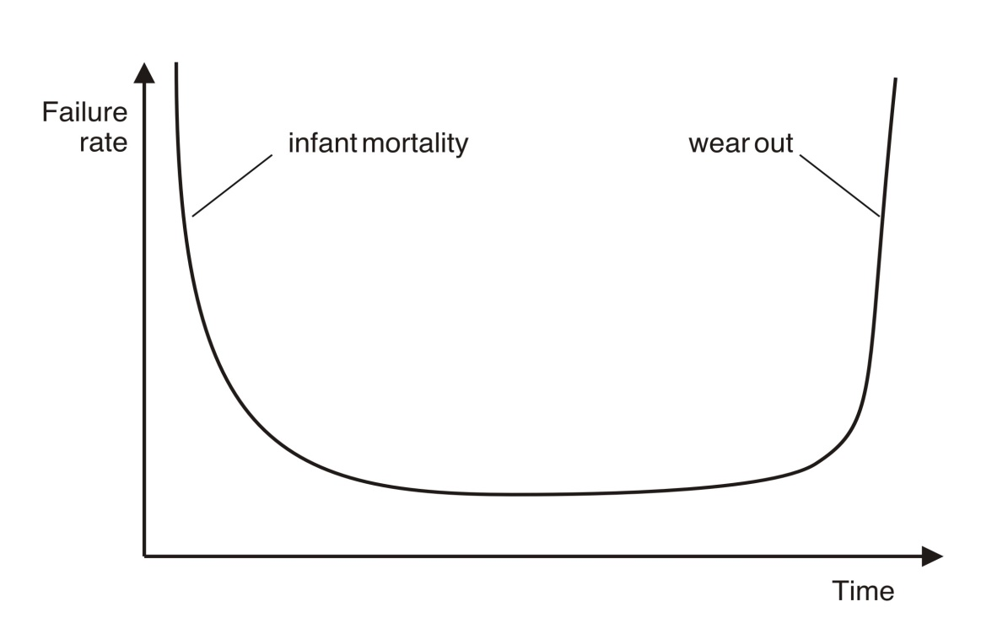
Wear Out （用尽）vs. Deterioration（退化）
Hardware wears out over time

Slide 59
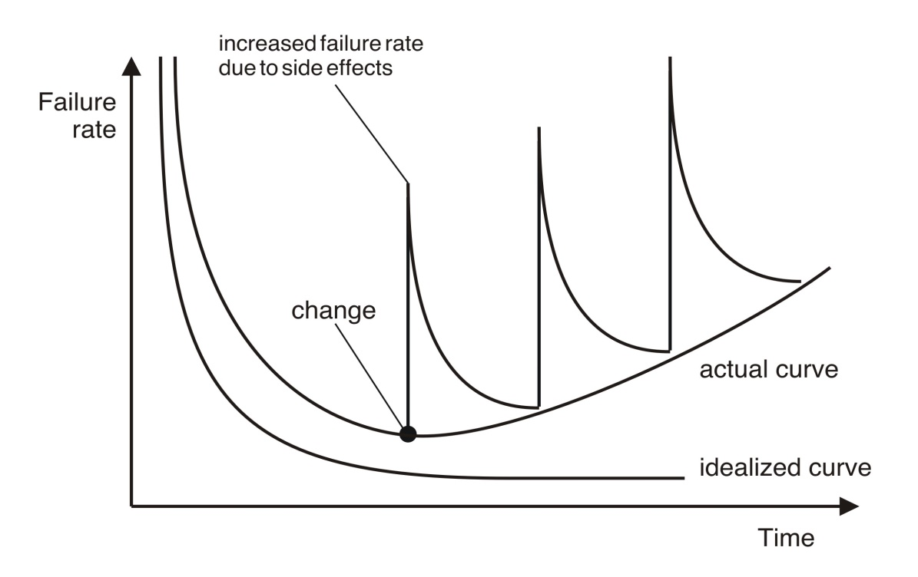
Wear Out （用尽）vs. Deterioration（退化）
Software deteriorates over time

Slide 60
Component-Based vs. Custom Built
Hardware products typically employ many standardized design components.
Most software continues to be custom built.
The software industry does seem to be moving (slowly) toward component-based construction.

Slide 61
Outline
The Evolving Role of Software
Software
The Changing Nature of Software
Legacy Software
Software Myths

Slide 62
Software Applications
system software
application software
engineering/scientific software
embedded software
product-line software
web applications
Artificial Intelligence software
Ubiquitous（普适） computing
Netsourcing（Outsourcing外包）
Open source
Please visit:
http://shareware.cnet.com/
http://sourceforge.net/

Slide 63
Software Complexity
I believe the hard part of building software to be the specification, design, and testing of this conceptual construct, not the labor of representing it and testing the fidelity（逼真） of the representation.
If this is true, building software will always be hard. There is inherently no silver bullet.
- Fred Brooks, “No Silver Bullet”
http://www.computer.org/computer/homepage/misc/Brooks/

Slide 64
Outline
The Evolving Role of Software
Software
The Changing Nature of Software
Legacy Software
Software Myths

Slide 65
Legacy Software
Why must it change?
  It must be fixed to eliminate errors.
  It must be enhanced to implement new functional and non-functional requirements

Slide 66
Legacy Software
What types of changes?
  Be adapted to meet the needs of new computing environments.
  Be enhanced to implement new business requirements.
  Be extended to make it interoperable with other systems.
  Be re-architected to make it viable（可实施的） within a network environment.

Slide 67
E-Type Systems
Software that has been implemented in a real-world computing context and will therefore evolve over time

Slide 68
Outline
The Evolving Role of Software
Software
The Changing Nature of Software
Legacy Software
Software Myths

Slide 69
Software Myths
  Affect managers, customers (and other non-technical stakeholders) and practitioners
  Are believable because they often have elements of truth,
but …
  Invariably lead to bad decisions,
therefore …
  Insist on reality as you navigate your way through software engineering

Slide 70
Software Myths
If we get behind schedule, we can add more programmers and catch up.
A general statement about objectives is sufficient to begin building programs.
Change in project requirements can be easily accommodated because software is flexible.

Slide 71
Software Myths
Once we write a working program, we’re done.
Until I get the program running, I have no way of assessing its quality.
The only deliverable work product for a successful project is the working program.
Software engineering will make us create too much documentation and will slow us down.

Slide 72
Management Myths
“We already have a book of standards and procedures for building software. It does provide my people with everything they need to know …”
“If my project is behind the schedule, I always can add more programmers to it and catch up …”
(a.k.a. “The Mongolian Horde concept”)
“If I decide to outsource the software project to a third party, I can just relax: Let them build it, and I will just pocket my profits …”

Slide 73
Customer Myths
“A general statement of objectives is sufficient to begin writing programs - we can fill in the details later …”
“Project requirements continually change but this change can easily be accommodated because software is flexible …”

Slide 74
Practitioner’s Myths
“Let’s start coding ASAP, because once we write the program and get it to work, our job is done …”
“Until I get the program running, I have no way of assessing its quality …”
“The only deliverable work product for a successful project is the working program …”
“Software engineering is baloney. It makes us create tons of paperwork, only to slow us down …”

Slide 75
Summary
The Evolving Role of Software
Software
The Changing Nature of Software
Legacy Software
Software Myths

